Slide 1
Music and Markets: Investigating the Relationship Between Spotify Music Sentiment and UK Stock Returns

Slide 2
Research Question
How does UK Spotify music sentiment relate with its FTSE Indices?
FTSE 100
(Large Cap)
Spotify
FTSE 250
(Mid Cap)
FTSE Small Cap

Slide 3
Contribution
Global Study Exists, UK Study is new
2017 – 2023 Data
Brings a fresh perspective on how music interacts with FTSE indices.
Sentiment on UK Stock Market

Slide 4

Methodology
OLS for Change of Music Sentiment -> Stock Returns
Over 5 business Days
Uses the SWAV metric
Basic Controls: Economic Policy Uncertainty, Macroeconomic Conditions, Market Volatility, Previous FTSE Returns, Global Returns, Cloud Cover
Other Controls….

Slide 5
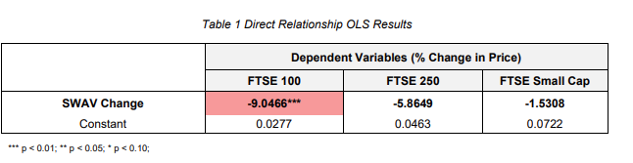
Findings
Direct Relationship

Slide 6
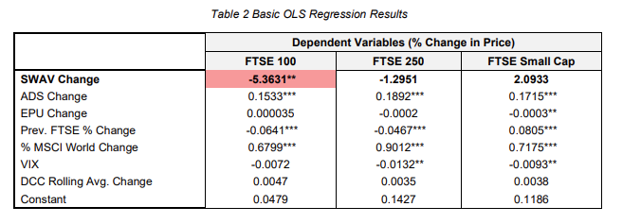
Findings
Basic Regression Controls

Slide 7
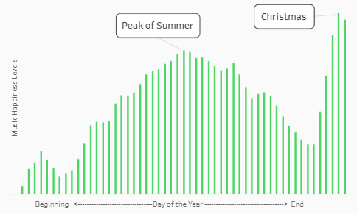
UK Spotify Listening Habits

Slide 8
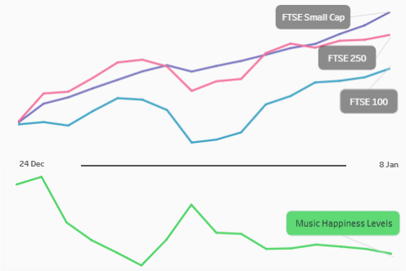
Holiday Cheer but Spotify Drops

Slide 9
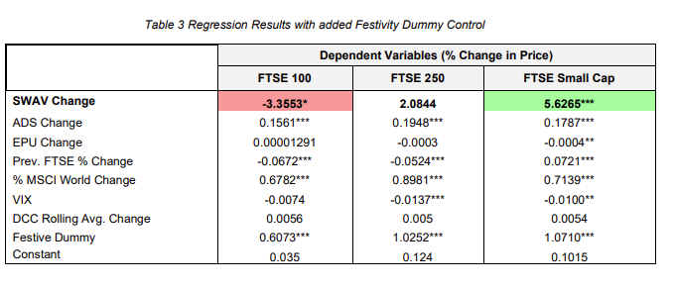
Findings
Basic Regression Controls + Festive Dummy

Slide 10
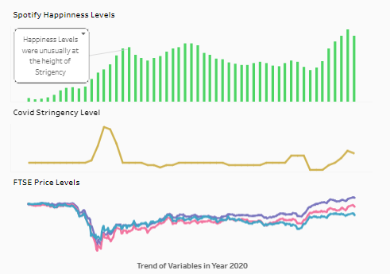
A Happy Surprise in Lockdown

Slide 11
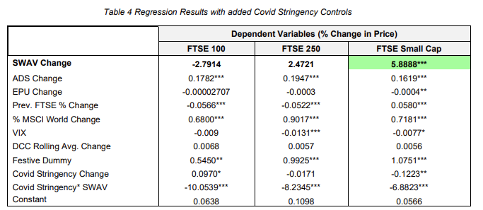
Findings
Basic Regression Controls + Festive Dummy + Covid Controls

Slide 12
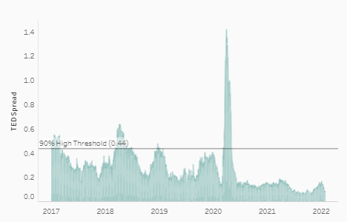
Spotlight on TED Spread

Slide 13
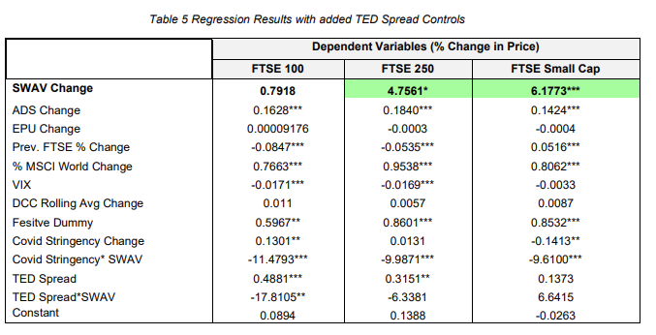
Findings
Basic Regression Controls + Festive Dummy + Covid Controls + TED Spread Controls

Slide 14
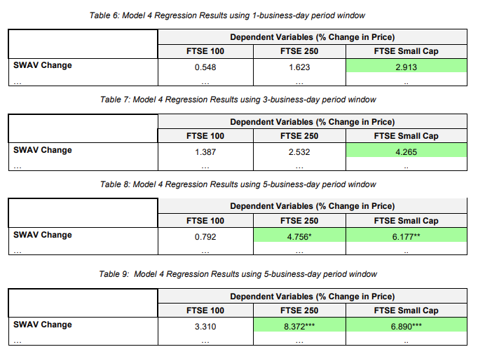
Window Period Analysis

Slide 15
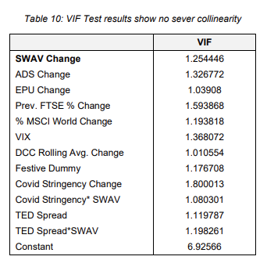
VIF Test Results

